Slide 1
Coventry University And GDUFS Project
Names: Dan , Helen , Ralfs , Deft ,Derek

Slide 2
Description
The web application named “Hao useful” is a student oriented interface for representing a database consisting of students and their majors.
It focuses on simplicity of use and efficient information lookup by only including the features that were identified as the most important ones

Slide 3
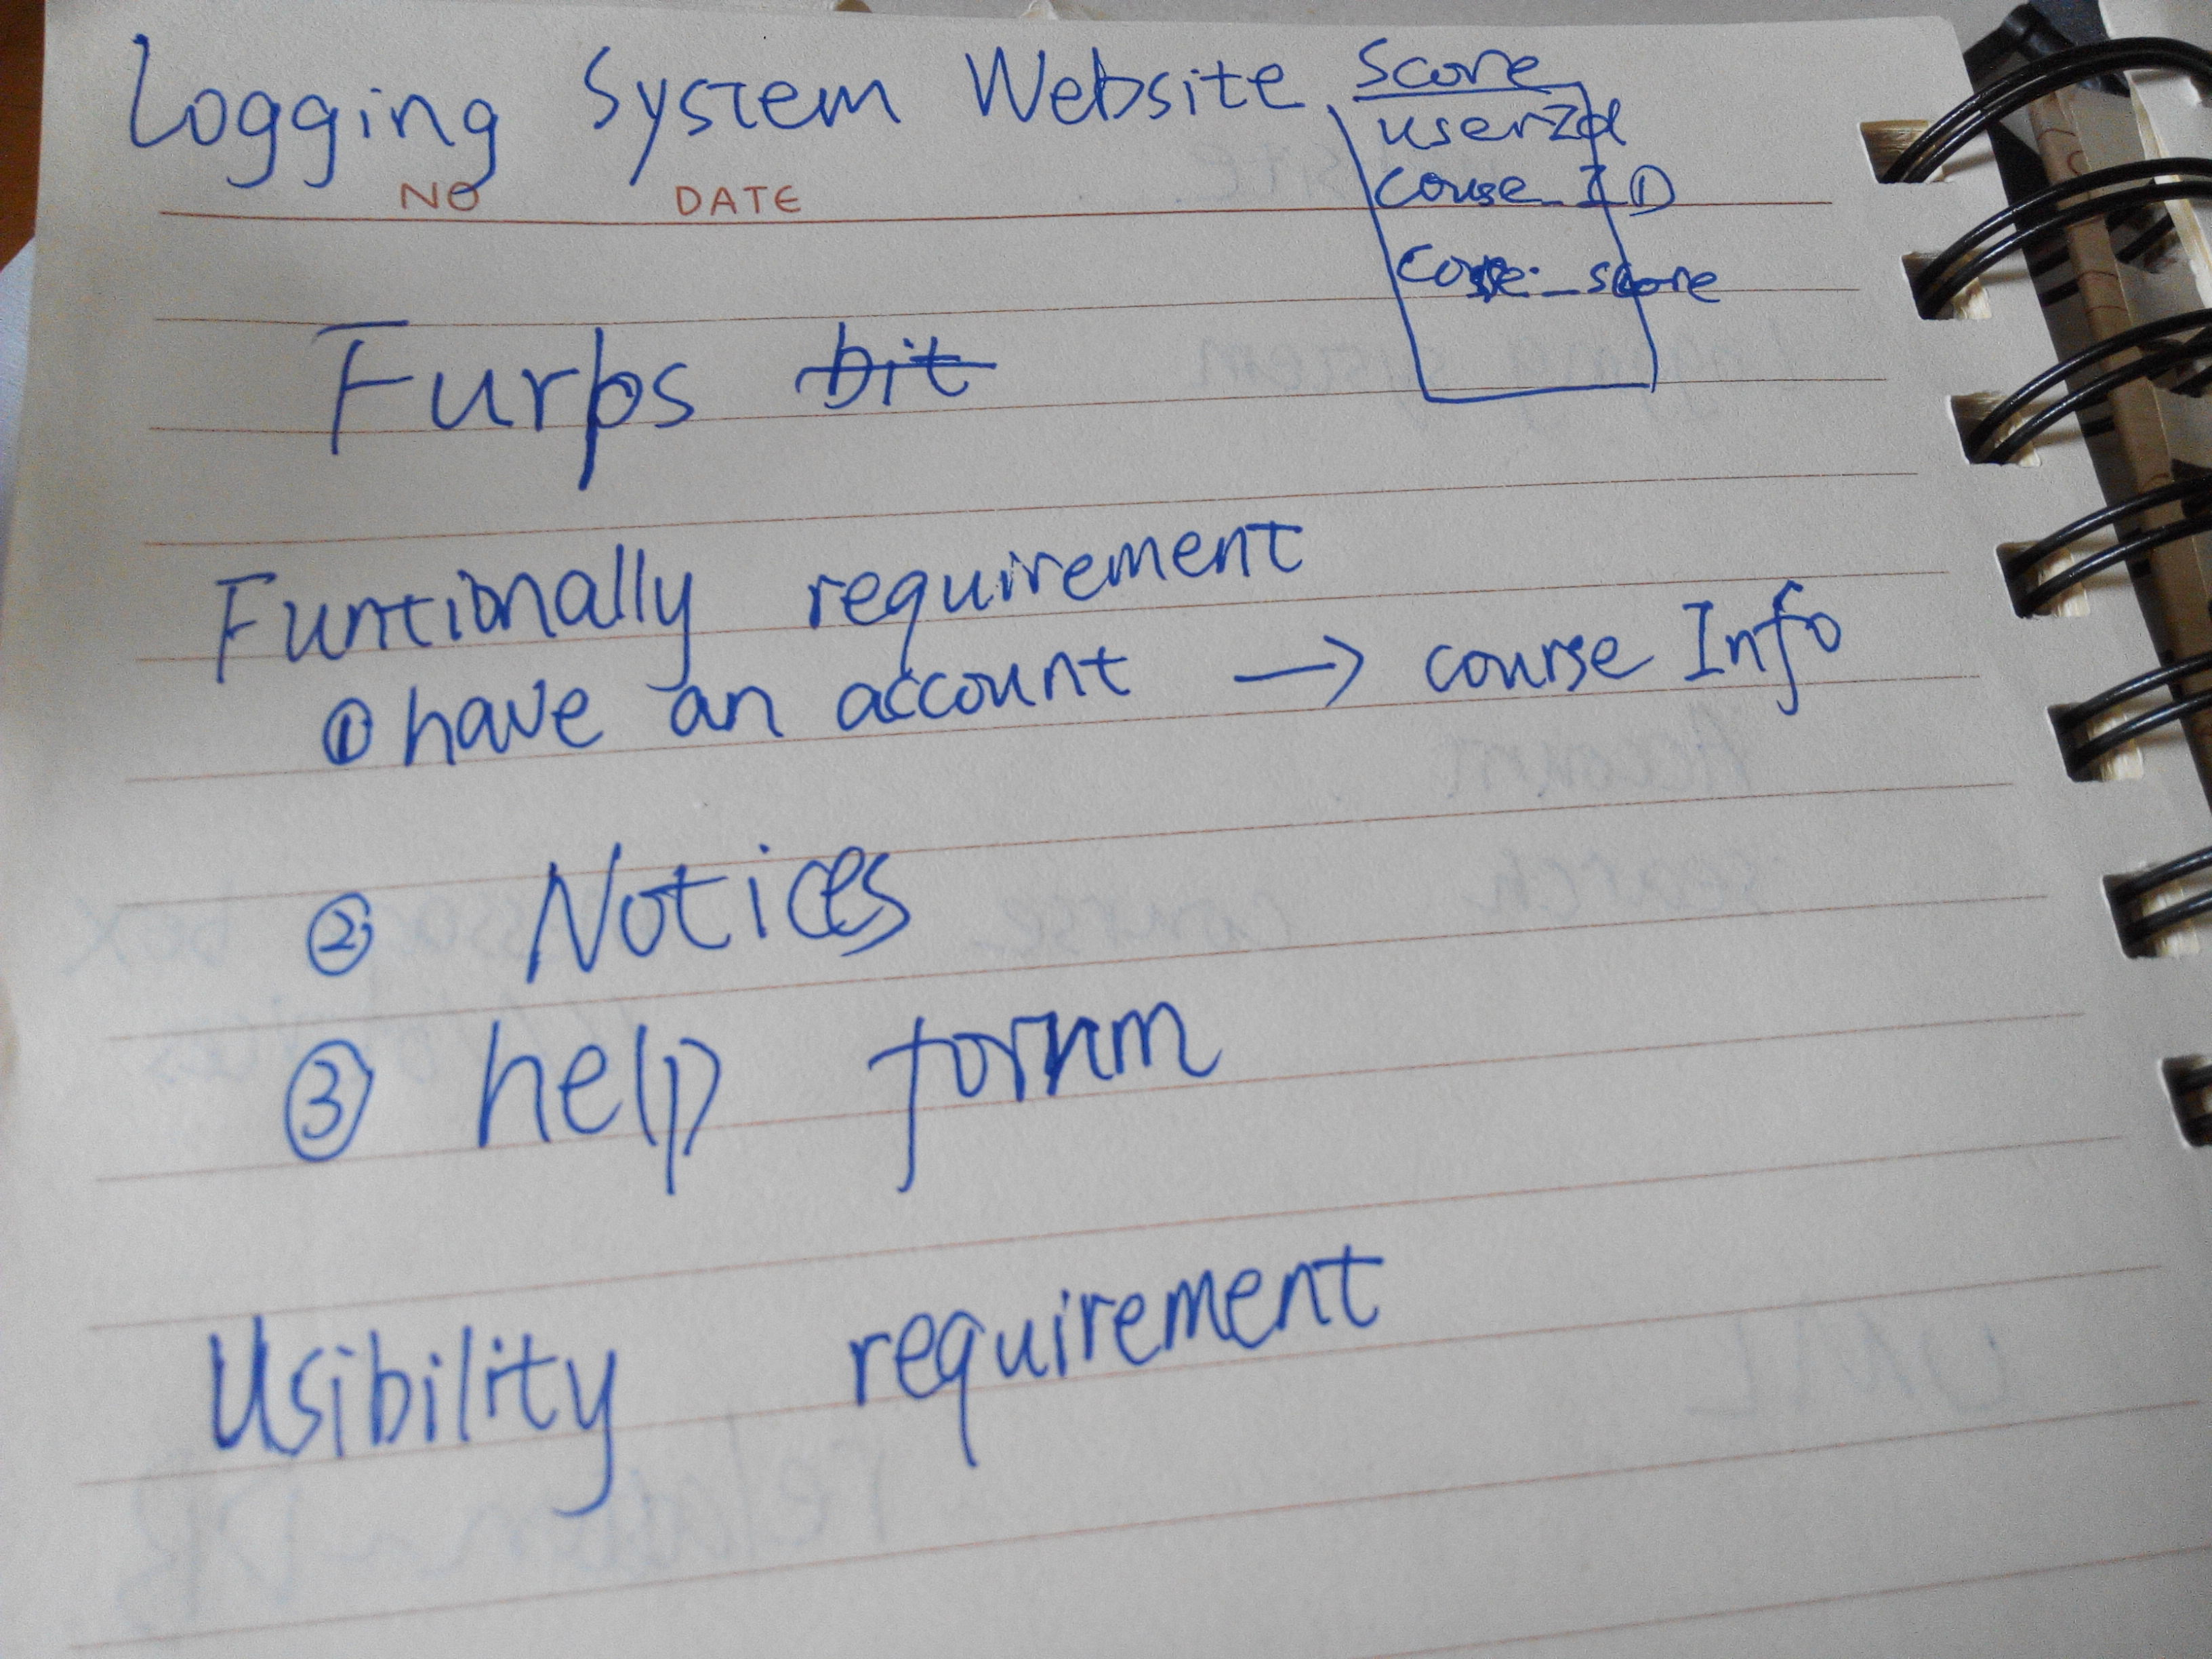
The Requirements
The requirements were generated by assessing the use cases of the application. The main aim was to create a very simple and straight forward representation about the student’s major and the modules associated with it.
The requirements are listed below -
- Efficiently accessible course information that is specific to the user
- Notifications bar that informs user about important events and changes
-A simple log in system that allows the user to see all of the modules that are associated with a Major

Slide 4
Team Roles
Team roles were assigned based on the preference and knowledge of the different aspects that are in the application. Because some of the roles were too small students were assigned multiple roles to help and speed up the process of building the application .
Database - Dan, Ralfs
PHP front end/back end - Main - Hellen, Deft; Helpers - Ralfs, Derek, Dan
HTML - Ralfs, Derek

Slide 5
Technology and Frameworks that have been used

Slide 6
Collaboration
Collaboration - C9 and Github were used to ensure that everyone has the same workspace and access to the latest project content with an easy to use push and pull system that people can use and understand.
C9 helped to break the restrictions imposed by different types of computers and their operating systems. It was also connected to Github so it was very easy to keep track of the project’s versions keeping them up to date at all times.

Slide 7
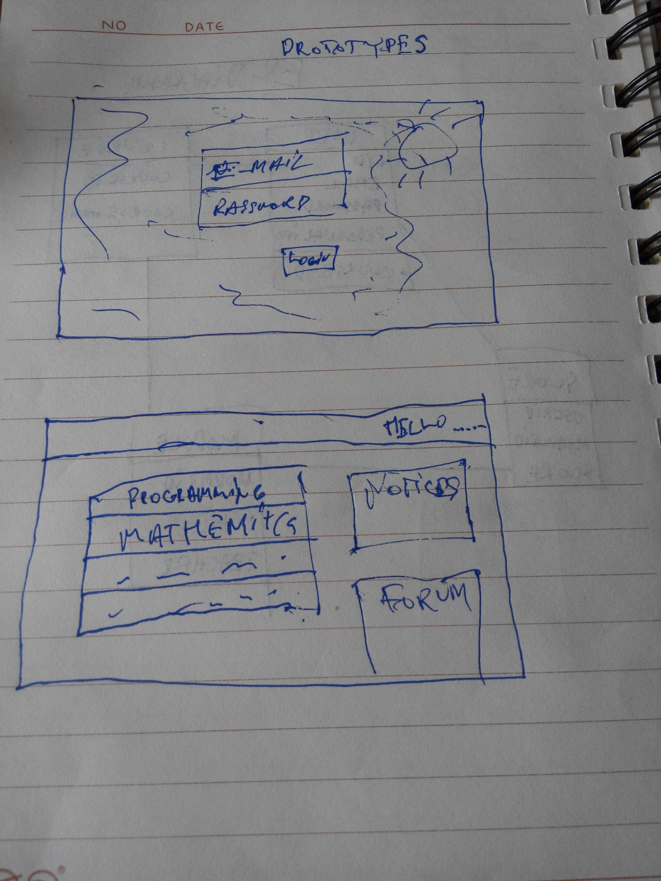
Design
Design - The website was created and designed using html and css with help of the Bootstrap framework.
This ensured that students could use the application on their mobile phones as well as their desktops.
The main design of the interface was taken from both of the student website’s as they both had some good ideas that we could take and use for our project.

Slide 8
Front end/ back end programming
Because of everyone’s familiarity with PHP it was used as the main language for manipulating data and behaviour. It was used for both front end and back end programming because the team decided that it would be easier to combine them.
Although some of the functions are there just for demo purposes and not yet implemented, the intended aims were achieved.

Slide 9
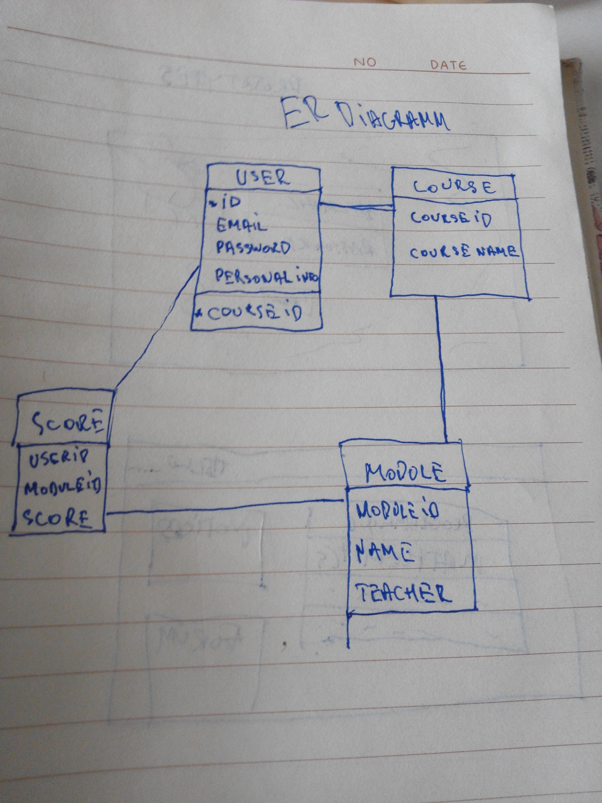
Database
As the data was identified as structured and the volume of it is not planned to exceed high numbers, Mysql was decided the best choice for this application.
The data is normalised and the connection to the database is made through PHP.

Slide 10
Challenges and Issues
The biggest challenges faced were coming up with an idea for the project and deciding what the project should be called the reason for this issue is due to the fact that we did not have a lot of time to make this project so we did not want to make anything too complicated.
More technical challenges were finding and combining the languages and frameworks that everyone was familiar with.
Team members worked on aspects they felt most comfortable with and shared their knowledge so everyone would understand the technical functionality of the application.
An important but very quickly solved challenge was finding the most suitable and efficient environment for development.

Slide 11
Future
The functionality of the application is very basic at the moment. In future all the static functionality should be implemented dynamically (help forum and notifications).
Administrators should be able to use it as easily as students so an administrator mode should be included in the application as well with such operations as - create, read, update, delete (CRUD) on students, courses, notifications and more.
As this is sensitive data some form of security should be considered as well - password hashing, securing connections, data encryption.

Slide 12
Demo of the Application
Here is a short demo of our application that hopefully showcases the main features of our project.

